Slide 1
Disaster Management Drone for Real-Time Mapping & Detection
Akash Shelar 240840143002
Mihir Harne 240840143003
Mohit Pawaskar 240840143005
Ojas Sannak 240840143006

Slide 2
Table of Content
Introduction
Aim
Components
Block Diagram
Flow Chart
Result
Conclusion

Slide 3
Introduction
Natural disasters like floods require fast and accurate response to save lives and minimize damage. Traditional methods are slow and risky, making real-time data crucial for emergency teams.
Our Disaster Management Drone is designed to:
- Map disaster-affected areas in real time using aerial imaging
- Detect survivors, debris, and fires using AI-based object detection
- Provide live video & data transmission for rescue operations
- Equipped with AI, this drone enhances situational awareness, speeds up disaster response, and improves search & rescue efficiency.

Slide 4
Aim of the Project
The aim of this project is to develop a Disaster Management Drone capable of real-time mapping and object detection to assist in search & rescue operations.
Objectives:
- Provide real-time aerial mapping of disaster-affected areas
- Detect survivors, vehicles, and debris using AI-based object detection
Transmit live video and data to emergency response team
This drone enhances situational awareness, speeds up disaster response, and improves rescue efficiency in critical situations.

Slide 5
Components
Frame: Tarot Iron Man 650 Carbon Fiber Fully Foldable Quadcopter Frame (TL65B01)
Battery: Orange 14.8V (4S) 5200mAh 40C LiPo Battery
Motors: Emax MT2213 935KV Brushless DC Motors (x4)
Electronic Speed Controllers (ESCs): 30A SimonK ESCs (x4)
Flight Controller: Pixhawk 2.4.8 with Ardupilot Firmware
Receiver: FlySky FS-iA6B 2.4GHz 6CH PPM/PWM Receiver
Telemetry: 433MHz Telemetry Module for Ground Control Communication
GPS Module: Ublox M8N GPS with Compass for Navigation
Propellers: 10.45-inch Carbon Fiber Propellers (x4)
Onboard Computer: Raspberry Pi 4 Model B (4GB/8GB RAM)
Camera: 5MP Raspberry Pi 3/4 Model B Camera Module Rev 1.3 with Cable

Slide 6
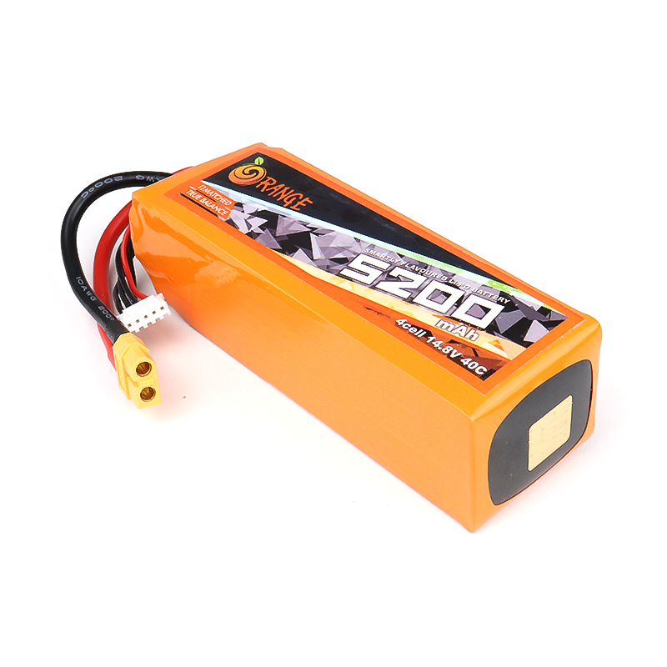
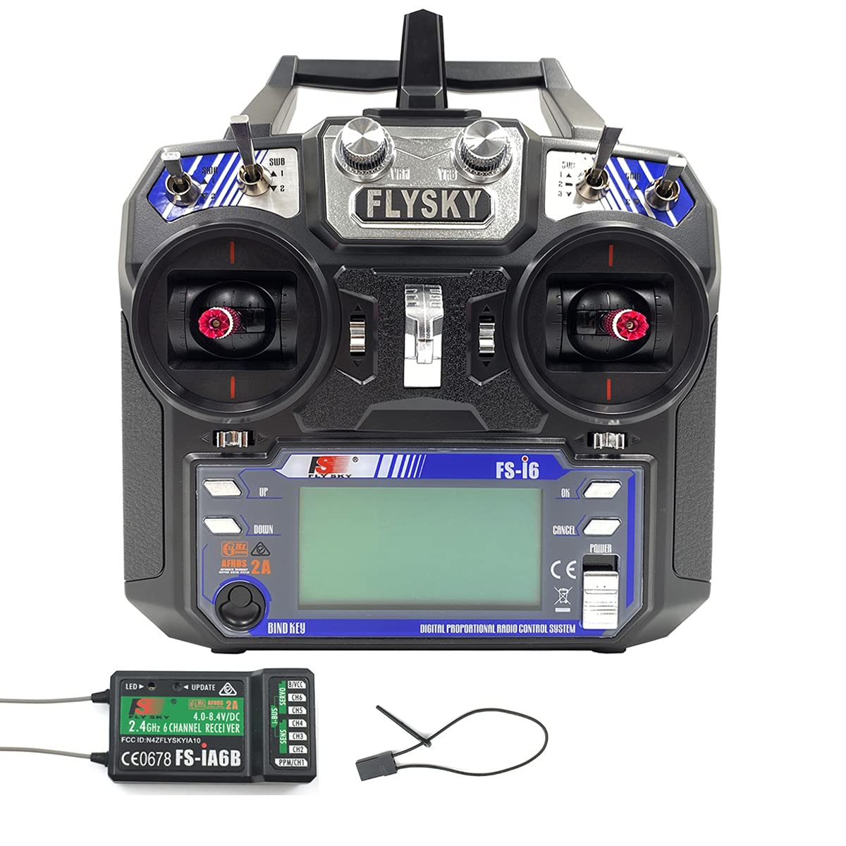
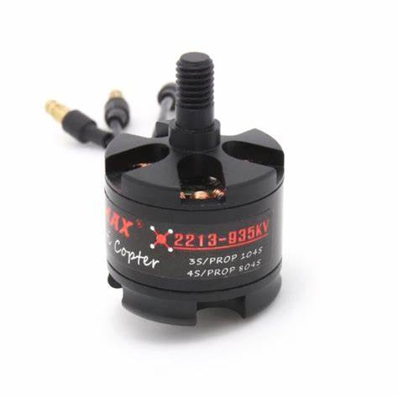
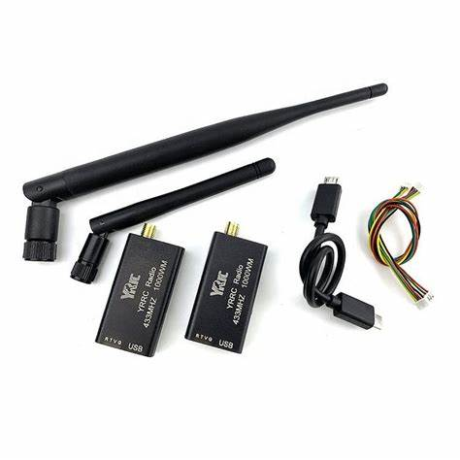
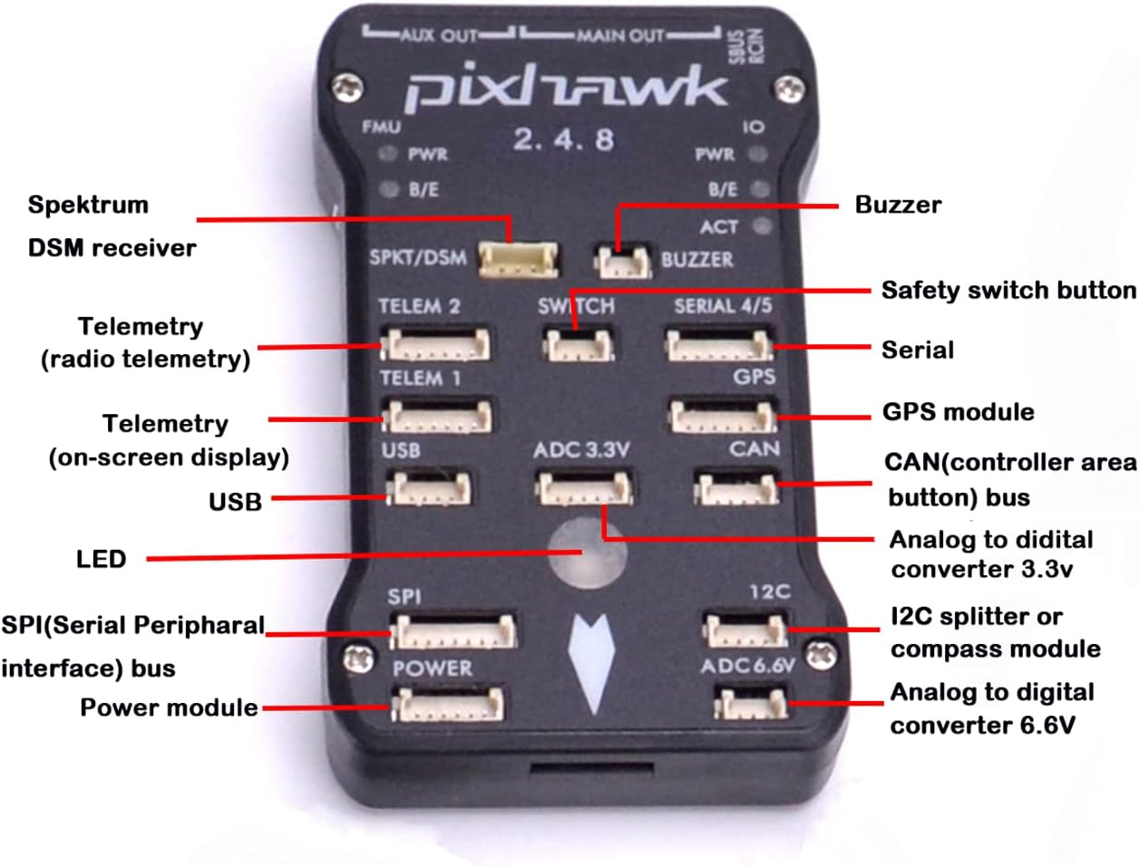
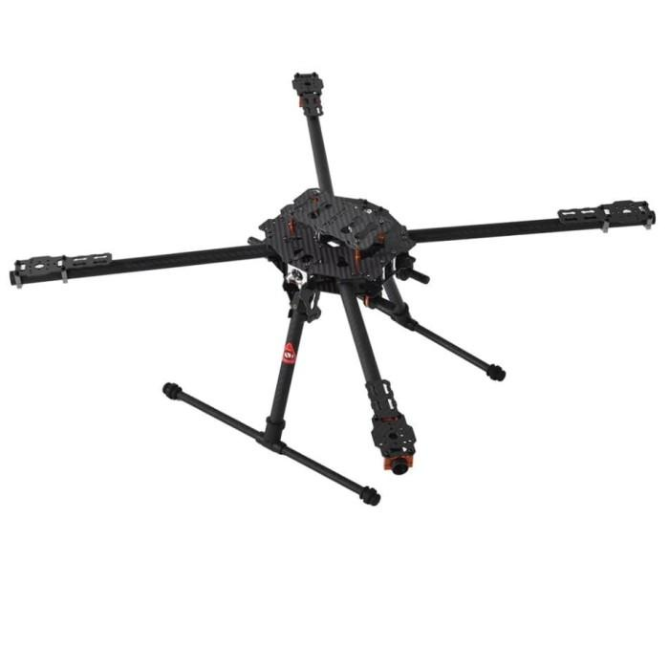
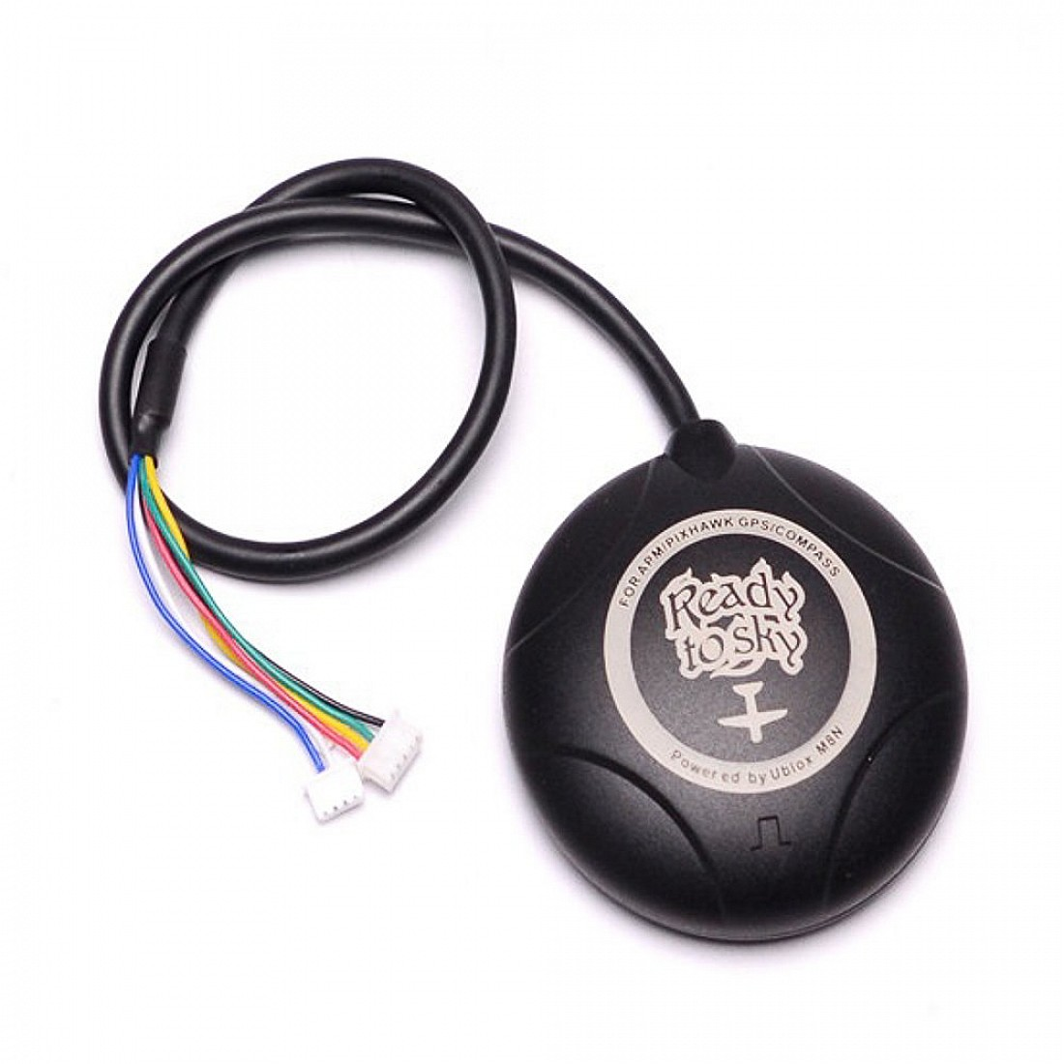
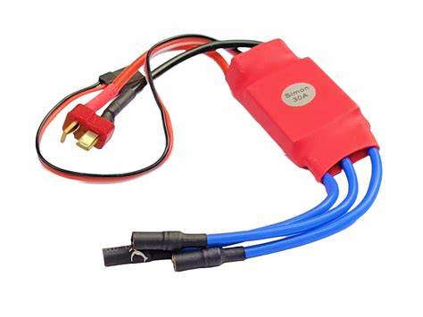
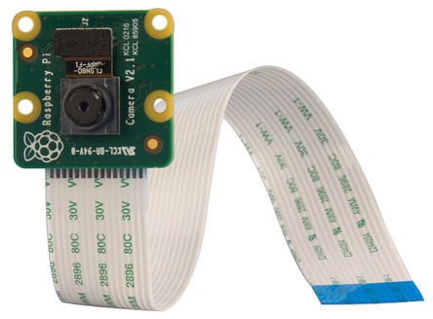
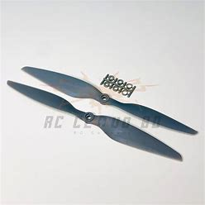

Slide 7
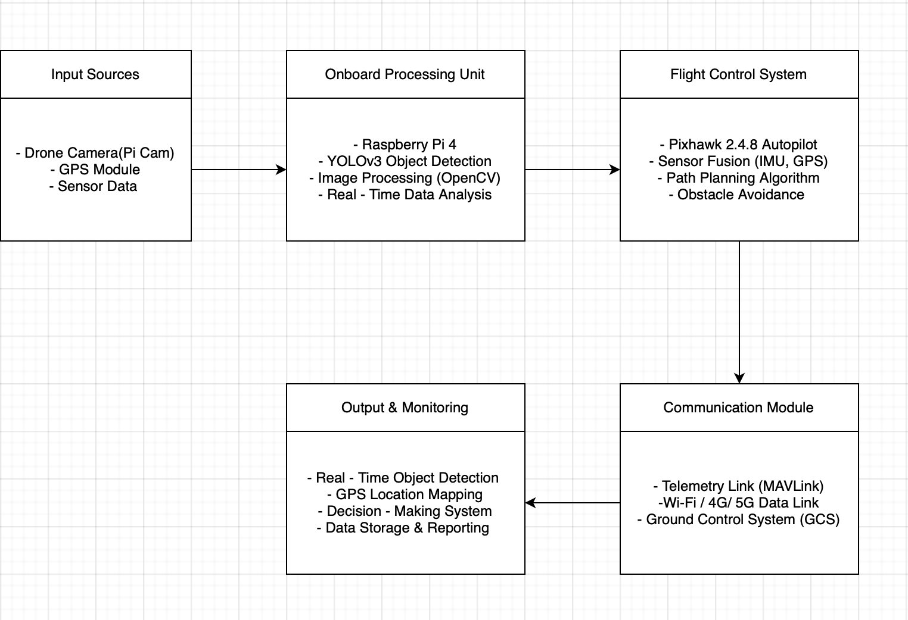
Block Diagram

Slide 8
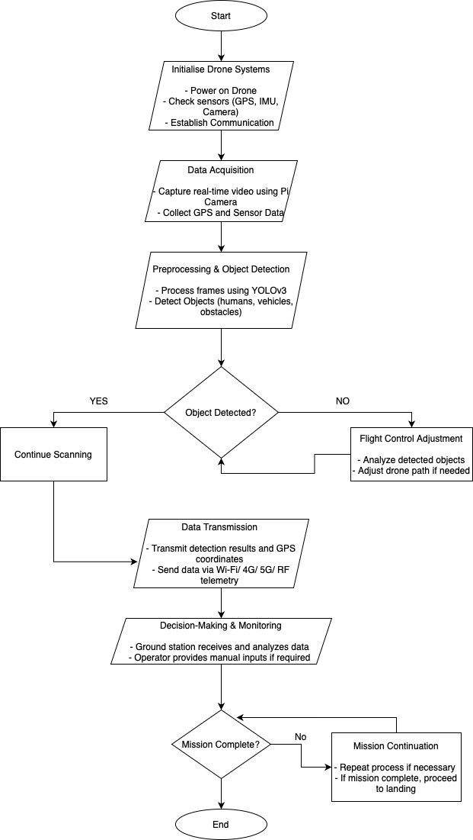
Flow Chart

Slide 9
Flight Endurance Calculation
Frame: -
Tarot Iron Man 650 Carbon Fiber Fully Foldable Quadcopter Frame TL65B01 Dimensions (L x W x H) mm: - 361.9 x 234.9 x 62 mm
Weight: - 476gm
Battery: -
Orange 14.8V 5200mAh 40C 4S Lithium Polymer Weight: - 488 gm
Capacity: - 5200 mAH
Voltage: - 14.8V Discharge: - 40C
Dimensions: 137 x 44 x 40 (L x W x H) (mm)
Motor: -
EMAX MT2213 935KV Brushless DC Motor Weight: - 53gm
Voltage: - 14.8
Max Power: - 220W(100%) 67W(50% )
Thrust: - 860 gm
Propellers: - 1045(10×4.5) 14gm
Weight Budget: - 1650gm
Frame: - 476 gm Battery: - 488gm Motor: - 268gm Avionics: - 500gm
Thrust Per Motor at 50% Throttle: - 500gm
Total Thrust for a Quadcopter (4 Motors) at 50% Throttle: - 2000gm
Power Per Motor at 50% Throttle: - 67 Watt
Total Power for a Quadcopter (4 Motors) at 50% Throttle: - 268 Watt
Total Capacity of Orange 14.8V 5200mAh 40C 4S LiPo Battery Total Capacity (Wh) =Voltage (V)×Capacity (Ah)
=14.8V×5.2Ah
= 76.96Wh

Slide 10
Available Capacity at 75%
Capacity in Wh (Watt-hours) =76.96Wh×0.75
=57.7 Wh
Calculate Endurance (Flight Time): -
Total Power Consumption (W) _{*60}
Endurance (hours) =
Available Battery Energy (Wh)
=
57.72 (W)
* 60
268Wh
Endurance (hours) =12.92 minutes

Slide 11
YOLO YOLOv3: You Only Look Once - Version 3
What is YOLOv3? YOLOv3 (You Only Look Once, version 3) is a real-time object detection algorithm that is fast and accurate. It uses a single neural network to process an image and detect multiple objects in one forward pass, making it significantly faster than traditional object detection methods.
Why Use YOLOv3?
Speed: Can run in real time with high FPS, making it suitable for applications like surveillance, autonomous vehicles, and drones.
Accuracy: Uses Darknet-53 as its backbone, improving detection accuracy, especially for smaller objects.
Single-Pass Detection: Unlike region-based methods (like Faster R-CNN), YOLOv3 processes the entire image at once, reducing computation time.
Multi-Scale Predictions: Detects objects at three different scales, improving its ability to detect objects of various sizes.
Flexibility: Can detect multiple object classes in a single pass, making it efficient for complex environments.

Slide 12
Workflow
Loading the YOLO Model
The pre-trained YOLOv3 model is loaded using OpenCV’s Deep Neural Network (DNN) module.
Class labels from the COCO dataset (80 object categories) are loaded for identification.
Processing Video Frames
A video file is read frame-by-frame.
Each frame is resized and converted into a blob, which is fed into the YOLO model.
The model processes the image and predicts bounding boxes, class labels, and confidence scores for detected objects.
Applying Object Detection
Confidence Thresholding: Objects with a confidence score above 50% are considered valid detections.
Non-Maximum Suppression (NMS): Overlapping boxes are filtered to keep only the most accurate ones.
Visualizing and Saving Results
Detected objects are highlighted using bounding boxes with labels and confidence scores.
The processed frames are saved into an output video.
Real-time visualization allows viewing detections during processing.

Slide 13
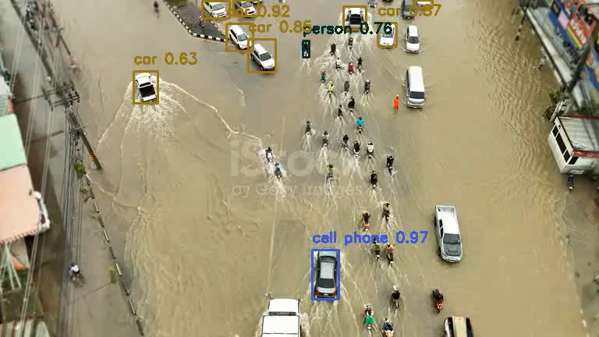
Result

Slide 14
Conclusion
The Disaster Management Drone successfully demonstrated its capability to enhance emergency response efforts by providing real-time aerial mapping, AI-based object detection, and live data transmission.
Key Outcomes:
Faster disaster assessment through autonomous aerial mapping.
Accurate object detection for identifying survivors, trapped Vehicles, etc.
Efficient search & rescue using real-time video and AI-powered analysis.
Improved situational awareness for emergency teams via live data transmission.

